Slide 1
UNIT-I
M 2 DIVIDE AND CONQUER
DESIGN AND ANALYSIS OF ALGORITHMS
M Yogi Reddy
Assistant Professor,
Dept. of CSE,
School Of Technology,
GITAM(Deemed to be ) University,
Hyderabad.
Yogi Reddy M, Asst. Prof

Slide 2
Agenda
Algorithm specification
Performance Analysis
Divide and Conquer:
  The general method
  Binary search,
  finding maximum and minimum,
  Merge sort
  Quick sort
  Selection (Quick-Select)
  Strassen’s Matrix multiplication.
Yogi Reddy M, Asst. Prof

Slide 3
Divide and Conquer Technique
General Method
The Divide and Conquer Technique splits n inputs into k subsets , 1< k ≤ n, yielding k sub-problems.
These sub-problems will be solved and then combined by using a separate method to get a solution to a whole problem.
If the sub-problems are large, then the Divide and Conquer Technique will be reapplied.
Often sub-problems resulting from a Divide and Conquer Technique are of the same type as the original problem.
For those cases the reapplication of the Divide and Conquer Technique is naturally expressed by a recursive algorithm.
Now smaller and smaller problems of the same kind are generated until sub-problems that are small enough to be solved without splitting are produced.
Yogi Reddy M, Asst. Prof

Slide 4
Algorithm DAndC(p)
{
if Small(p) then
return s(p);
else
{
Divide p into smaller instances p1,p2,…….,pk, k≥1;
Apply DAndC to each of these sub-problems;
return Combine(DAndC(p1), DAndC(p2),……,DAndC(pk));
}
}
Yogi Reddy M, Asst. Prof

Slide 5
If the size of p is n and the sizes of the k sub-problems are n1,n2,….,nk, then the computing time of DAndC is described by the recurrence relation
g( n) n small
T(n) =
T(n₁)+T(n₂)+……+T(n_{k})+f(n) Otherwise
Where T(n) is the time for DAndC on any input of size n and g(n) is the time to compute the answer directly for small inputs.
The function f(n) is the time for dividing p and combining the solutions to sub-problems.
Yogi Reddy M, Asst. Prof

Slide 6
The Complexity of many divide-and-conquer algorithms is given by recurrences of the form
T(1) n=1
a T(n/b) + f(n) n>1
Where a and b are known constants.
We assume that T(1) is known and n is a power of b (i.e n=b^{k} )
T(n)=
Yogi Reddy M, Asst. Prof

Slide 7
Applications of DandC
1. Binary search Algorithm
Iterative algorithm
Algorithm BinSearch(a,n,x)
{
low:=1; high:=n;
while(low≤high)
{
mid:=(low+high)/2;
if( x<a[mid] ) then high:=mid-1;
else if( x> a[mid] ) then low:=mid+1;
else return mid;
}
return 0;
}
Yogi Reddy M, Asst. Prof

Slide 8
Recursive Algorithm ( Divide and Conquer Technique)
Algorithm BinSrch (a,i,l,x)
//given an array a [i:l]of elements in nondecreasing
//order,1≤i≤l,determine whether x is present,and
//if so, return j such that x=a[j]; else return 0.
{
if(l=i) then // If small(P)
{
if(x=a[i]) then return i;
else return 0;
}
else
{ //Reduce p into a smaller subproblem.
mid:= (i+l)/2
  if(x=a[mid]) then return mid;
  else if (x<a[mid]) then
  return BinSrch (a,i,mid-1,x);
  else return BinSrch(a,mid+1,l,x);
  }
  }
Yogi Reddy M, Asst. Prof

Slide 9
Time complexity of Binary Search
If the time for diving the list is a constant, then the computing time for binary
search is described by the recurrence relation
c₁ n=1, c1 is a constant
T(n) =
T(n/2) + c₂ n>1, c2 is a constant
    T(n) = T(n/2) + c2
    =T(n/4)+c2+c2
    =T(n/8) +c2+c2+c2
    =T(n/2³) +3c2
    …..
    …..
    = T(1)+ kc2
    = c1+kc2 =c1+ logn*c2 = O(logn)
Assume n=2^{k}, then
Yogi Reddy M, Asst. Prof

Slide 10
Time Complexity of Binary Search
Successful searches:
best average worst
O(1) O(log n) O( log n)
Unsuccessful searches :
best average worst
O(log n) O(log n) O( log n)
Yogi Reddy M, Asst. Prof

Slide 11
2. Merge Sort
Base Case, solve the problem directly if it is small enough(only one element).
Divide the problem into two or more similar and smaller subproblems.
Recursively solve the subproblems.
Combine solutions to the subproblems.
Yogi Reddy M, Asst. Prof

Slide 12
Merge Sort: Idea
Divide into
two halves
A
FirstPart
SecondPart
Recursively sort
Recursively sort
FirstPart
SecondPart
Merge
A is sorted!
Yogi Reddy M, Asst. Prof
Notes:
Divide: if the initial array A has at least two elements (nothing needs to be done if A has zero or one elements), divide A into two subarrays each containing about half of the elements of A.
Conquer: sort the two subarrays using Merge Sort.
Combine: merging the two sorted subarray into one sorted array

Slide 13
Merge-Sort(A, 0, 7)
Divide
A:
6 2 8 4
3 7 5 1
6 2 8 4 3 7 5 1
Yogi Reddy M, Asst. Prof

Slide 14
Merge-Sort(A, 0, 7)
Merge-Sort(A, 0, 3)
, divide
A:
3 7 5 1
6 2
8 4
6 2 8 4
Yogi Reddy M, Asst. Prof

Slide 15
Merge-Sort(A, 0, 7)
Merge-Sort(A, 0, 1)
, divide
A:
3 7 5 1
8 4
6
2
6 2
Yogi Reddy M, Asst. Prof

Slide 16
Merge-Sort(A, 0, 7)
Merge-Sort(A, 0, 0)
, base case
A:
3 7 5 1
8 4
2
6
Yogi Reddy M, Asst. Prof

Slide 17
Merge-Sort(A, 0, 7)
Merge-Sort(A, 0, 0), return
A:
3 7 5 1
8 4
6
2
Yogi Reddy M, Asst. Prof

Slide 18
Merge-Sort(A, 0, 7)
Merge-Sort(A, 1, 1)
, base case
A:
3 7 5 1
8 4
6
2
Yogi Reddy M, Asst. Prof

Slide 19
Merge-Sort(A, 0, 7)
Merge-Sort(A, 1, 1), return
A:
3 7 5 1
8 4
6
2
Yogi Reddy M, Asst. Prof

Slide 20
Merge-Sort(A, 0, 7)
Merge(A, 0, 0, 1)
A:
3 7 5 1
8 4
2 6
Yogi Reddy M, Asst. Prof

Slide 21
Merge-Sort(A, 0, 7)
Merge-Sort(A, 0, 1), return
A:
3 7 5 1
2 6
8 4
Yogi Reddy M, Asst. Prof

Slide 22
Merge-Sort(A, 0, 7)
Merge-Sort(A, 2, 3)
, divide
A:
3 7 5 1
2 6
8
4
8 4
Yogi Reddy M, Asst. Prof

Slide 23
Merge-Sort(A, 0, 7)
Merge-Sort(A, 2, 2), base case
A:
3 7 5 1
2 6
4
8
Yogi Reddy M, Asst. Prof

Slide 24
Merge-Sort(A, 0, 7)
Merge-Sort(A, 2, 2), return
A:
3 7 5 1
2 6
8
4
Yogi Reddy M, Asst. Prof

Slide 25
Merge-Sort(A, 0, 7)
Merge-Sort(A, 3, 3), base case
A:
2 6
8
4
Yogi Reddy M, Asst. Prof

Slide 26
Merge-Sort(A, 0, 7)
Merge-Sort(A, 3, 3), return
A:
3 7 5 1
2 6
8
4
Yogi Reddy M, Asst. Prof

Slide 27
Merge-Sort(A, 0, 7)
Merge(A, 2, 2, 3)
A:
3 7 5 1
2 6
4 8
Yogi Reddy M, Asst. Prof

Slide 28
Merge-Sort(A, 0, 7)
Merge-Sort(A, 2, 3), return
A:
3 7 5 1
2 6
4 8
Yogi Reddy M, Asst. Prof

Slide 29
Merge-Sort(A, 0, 7)
Merge(A, 0, 1, 3)
A:
3 7 5 1
2 4 6 8
Yogi Reddy M, Asst. Prof

Slide 30
Merge-Sort(A, 0, 7)
Merge-Sort(A, 0, 3), return
A:
2 4 6 8
3 7 5 1
Yogi Reddy M, Asst. Prof

Slide 31
Merge-Sort(A, 0, 7)
Merge-Sort(A, 4, 7)
A:
2 4 6 8
3 7 5 1
Yogi Reddy M, Asst. Prof

Slide 32
Merge-Sort(A, 0, 7)
Merge (A, 4, 5, 7)
A:
2 4 6 8
1 3 5 7
Yogi Reddy M, Asst. Prof

Slide 33
Merge-Sort(A, 0, 7)
Merge-Sort(A, 4, 7), return
A:
2 4 6 8
1 3 5 7
Yogi Reddy M, Asst. Prof

Slide 34
Merge-Sort(A, 0, 7)
Merge-Sort(A, 0, 7), done!
Merge(A, 0, 3, 7)
A:
1 2 3 4 5 6 7 8
Yogi Reddy M, Asst. Prof

Slide 35
Ex:- [ 179, 254, 285, 310, 351, 423, 450, 520, 652,861 ]
Tree of calls of merge sort
1,10
1,5
6,10
1,3
4,5
6,8
9,10
1,2
3,3
4,4
5,5
6,7
8,8
9,9
10,10
1,1
2,2
6,6
7,7
Yogi Reddy M, Asst. Prof

Slide 36
Merge Sort: Algorithm
MergeSort ( low,high)
// sorts the elements a[low],…,a[high] which reside in the global array
//a[1:n] into ascending order.
// Small(p) is true if there is only one element to sort. In this case the list is
// already sorted.
{ if ( low<high ) then // if there are more than one element
{ mid ← (low+high)/2;
    MergeSort(low,mid);
    MergeSort(mid+1, high);
    Merge(low, mid, high);
}
}
Recursive Calls
Yogi Reddy M, Asst. Prof

Slide 37
Algorithm Merge(low,mid,high)
// a[low:high] is a global array containing two sorted subsets in a[low:mid]
// and in a[mid+1:high]. The goal is to merge these two sets into a single set
// residing in a [low:high]. b[ ] is a temporary global array.
{
k:=low; i:=low; j:=mid+1;
while( i ≤ mid ) and ( j ≤ high ) do
{
if( a[i] ≤ a[j] ) then
{
b[k]:=a[i]; i:=i+1;
}
else
{
b[k]:=a[j]; j:=j+1;
}
k:=k+1;
}
Yogi Reddy M, Asst. Prof

Slide 38
while(i<=mid)
{
b[k] := a[i];
i := i+1;
k := k+1
}
while(j<=high)
{
b[k] := a[j];
j := j+1;
k := k+1
}
for(i=low; i<=high; i++)
a[i]=b[i];
}
Yogi Reddy M, Asst. Prof

Slide 39
Merge-Sort: Merge Example
low
mid
high
A:
2
3
7
8
1
4
5
6
5
5
15
28
30
6
10
14
B:
5
5
15
28
30
6
10
14
L:
R:
3
5
15
28
6
10
14
22
Yogi Reddy M, Asst. Prof

Slide 40
Merge-Sort: Merge Example
A:
5
5
15
28
30
6
10
14
B:
3
1
5
15
28
30
6
10
14
k=low
L:
R:
3
2
15
3
28
7
30
8
6
1
10
4
14
5
22
6
i=low
j=mid+1
Yogi Reddy M, Asst. Prof

Slide 41
Merge-Sort: Merge Example
A:
5
5
15
28
30
6
10
14
B:
1
2
5
15
28
30
6
10
14
k
L:
R:
3
2
5
3
15
7
28
8
6
1
10
4
14
5
22
6
i
j
Yogi Reddy M, Asst. Prof

Slide 42
Merge-Sort: Merge Example
A:
5
5
15
28
30
6
10
14
B:
1
2
3
15
28
30
6
10
14
k
L:
R:
2
3
7
8
6
1
10
4
14
5
22
6
i
j
Yogi Reddy M, Asst. Prof

Slide 43
Merge-Sort: Merge Example
A:
5
5
15
28
30
6
10
14
B:
1
2
3
4
6
10
14
k
L:
R:
2
3
7
8
6
1
10
4
14
5
22
6
i
j
Yogi Reddy M, Asst. Prof

Slide 44
Merge-Sort: Merge Example
A:
5
5
15
28
30
6
10
14
B:
1
2
3
4
5
6
10
14
k
L:
R:
2
3
7
8
6
1
10
4
14
5
22
6
i
j
Yogi Reddy M, Asst. Prof

Slide 45
Merge-Sort: Merge Example
A:
5
5
15
28
30
6
10
14
B:
1
2
3
4
5
6
6
10
14
k
L:
R:
2
3
7
8
6
1
10
4
14
5
22
6
i
j
Yogi Reddy M, Asst. Prof

Slide 46
Merge-Sort: Merge Example
A:
5
5
15
28
30
6
10
14
B:
1
2
3
4
5
6
7
14
k
L:
R:
2
3
7
8
6
1
10
4
14
5
22
6
i
j
Yogi Reddy M, Asst. Prof

Slide 47
Merge-Sort: Merge Example
A:
5
5
15
28
30
6
10
14
B:
1
2
3
4
5
6
7
8
14
k
L:
R:
3
2
5
3
15
7
28
8
6
1
10
4
14
5
22
6
i
j
Yogi Reddy M, Asst. Prof

Slide 48
Merge-Sort: Merge Example
A:
5
5
15
28
30
6
10
14
B:
1
2
3
4
5
6
7
8
k
L:
R:
3
2
5
3
15
7
28
8
6
1
10
4
14
5
22
6
i
j
Yogi Reddy M, Asst. Prof

Slide 49
A:
5
5
15
28
30
6
10
14
B:
1
2
3
4
5
6
7
8
Yogi Reddy M, Asst. Prof

Slide 50
Merge-Sort Analysis using Recursion tree method
n
n/2
n/2
n/4
n/4
n/4
n/4
2
2
2
Yogi Reddy M, Asst. Prof

Slide 51
Merge-Sort Time Complexity
If the time for the merging operation is proportional to n, then the computing time for merge sort is described by the recurrence relation
c₁
n=1, c₁ is a constant
T(n) =
2T(n/2) + c₂n
n>1, c₂ is a constant
Assume n=2^{k}, then
    T(n) =2T(n/2) + c₂n
    =2(2T(n/4)+c2n/2)+c2n
    =4T(n/4)+2c₂n
    …..
    …..
    =2^{k} T(1)+ kc₂n
    = c₁n+c₂nlogn = = O(nlogn)
Yogi Reddy M, Asst. Prof

Slide 52
Summary
Merge-Sort
  Most of the work done in combining the solutions.
  Best case takes O(n log(n)) time
  Average case takes O(n log(n)) time
  Worst case takes O(n log(n)) time
Yogi Reddy M, Asst. Prof
Notes:
no specific input triggers worst-case behavior
the worst-case is only determined by the output of the random-number generator
Disadvantage:
Unstable in running time
Finding “pivot” element is a big issue!

Slide 53
3. QUICK SORT
Quick sort is a divide and conquer technique of sorting elements.
Quick sort was invented by Sir Charles Antony Richard Hoare in 1960.
Quick sort does the following:
  Select and place the pivot in its place
  Recursively sort both the sides of the pivot.
Yogi Reddy M, Asst. Prof

Slide 54
Divide:
    Pick any element as the pivot, e.g, the first element
    Partition the remaining elements into
        FirstPart, which contains all elements < pivot
        SecondPart, which contains all elements > pivot
Recursively sort FirstPart and SecondPart.
Combine: no work is necessary since sorting is done in place.
Yogi Reddy M, Asst. Prof
Notes:
since sorting is done in place

Slide 55
pivot divides a into two sublists x and y.
4
4
2
2
7
7
8
8
1
1
9
9
3
3
6
6
5
5
pivot
4
x
y
Yogi Reddy M, Asst. Prof

Slide 56
Quicksort
In this method, an element called pivot is identified and that element is fixed in its place by moving all the elements less than that to its left and all the elements greater than that to its right.
Procedure:
If array only contains one element, return it.
Else
  Pick one element to use as pivot.
  Partition elements into two sub-arrays
    Elements less than or equal to pivot
    Elements greater than pivot
  Quicksort two sub-arrays.
  4. Return results.
Yogi Reddy M, Asst. Prof

Slide 57
pivot_index = 0
40
20
10
80
60
50
7
30
100
[0] [1] [2] [3] [4] [5] [6] [7] [8]
i
j
Yogi Reddy M, Asst. Prof

Slide 58
While data[i] <= data[pivot]
++i
pivot_index = 0
40
20
10
80
60
50
7
30
100
[0] [1] [2] [3] [4] [5] [6] [7] [8]
i
j
Yogi Reddy M, Asst. Prof

Slide 59
While data[i] <= data[pivot]
++i
pivot_index = 0
40
20
10
80
60
50
7
30
100
[0] [1] [2] [3] [4] [5] [6] [7] [8]
i
j
Yogi Reddy M, Asst. Prof

Slide 60
While data[i] <= data[pivot]
++i
pivot_index = 0
40
20
10
80
60
50
7
30
100
[0] [1] [2] [3] [4] [5] [6] [7] [8]
i
j
Yogi Reddy M, Asst. Prof

Slide 61
While data[i] <= data[pivot]
  ++i
While data[j] > data[pivot]
  --j
pivot_index = 0
40
20
10
80
60
50
7
30
100
[0] [1] [2] [3] [4] [5] [6] [7] [8]
i
j
Yogi Reddy M, Asst. Prof

Slide 62
While data[i] <= data[pivot]
  ++i
While data[j] > data[pivot]
  --j
pivot_index = 0
40
20
10
80
60
50
7
30
100
[0] [1] [2] [3] [4] [5] [6] [7] [8]
i
j
Yogi Reddy M, Asst. Prof

Slide 63
While data[i] <= data[pivot]
  ++i
While data[j] > data[pivot]
  --j
If i < j
  swap data[i] and data[j]
pivot_index = 0
40
20
10
80
60
50
7
30
100
[0] [1] [2] [3] [4] [5] [6] [7] [8]
i
j
Yogi Reddy M, Asst. Prof

Slide 64
While data[i] <= data[pivot]
  ++i
While data[j] > data[pivot]
  --j
If i < j
  swap data[i] and data[j]
pivot_index = 0
40
20
10
30
60
50
7
80
100
[0] [1] [2] [3] [4] [5] [6] [7] [8]
i
j
Yogi Reddy M, Asst. Prof

Slide 65
While data[i] <= data[pivot]
  ++i
While data[j] > data[pivot]
  --j
If i < j
  swap data[i] and data[j]
While j > i, go to 1.
pivot_index = 0
40
20
10
30
60
50
7
80
100
[0] [1] [2] [3] [4] [5] [6] [7] [8]
i
j
Yogi Reddy M, Asst. Prof

Slide 66
While data[i] <= data[pivot]
  ++i
While data[j] > data[pivot]
  --j
If i < j
  swap data[i] and data[j]
While j > i, go to 1.
pivot_index = 0
40
20
10
30
60
50
7
80
100
[0] [1] [2] [3] [4] [5] [6] [7] [8]
i
j
Yogi Reddy M, Asst. Prof

Slide 67
While data[i] <= data[pivot]
  ++i
While data[j] > data[pivot]
  --j
If i < j
  swap data[i] and data[j]
While j > i, go to 1.
pivot_index = 0
40
20
10
30
60
50
7
80
100
[0] [1] [2] [3] [4] [5] [6] [7] [8]
i
j
Yogi Reddy M, Asst. Prof

Slide 68
While data[i] <= data[pivot]
  ++i
While data[j] > data[pivot]
  --j
If i < j
  swap data[i] and data[j]
While j > i, go to 1.
pivot_index = 0
40
20
10
30
60
50
7
80
100
[0] [1] [2] [3] [4] [5] [6] [7] [8]
i
j
Yogi Reddy M, Asst. Prof

Slide 69
While data[i] <= data[pivot]
  ++i
While data[j] > data[pivot]
  --j
If i < j
  swap data[i] and data[j]
While j > i, go to 1.
pivot_index = 0
40
20
10
30
60
50
7
80
100
[0] [1] [2] [3] [4] [5] [6] [7] [8]
i
j
Yogi Reddy M, Asst. Prof

Slide 70
While data[i] <= data[pivot]
  ++i
While data[j] > data[pivot]
  --j
If i < j
  swap data[i] and data[j]
While j > i, go to 1.
pivot_index = 0
40
20
10
30
60
50
7
80
100
[0] [1] [2] [3] [4] [5] [6] [7] [8]
i
j
Yogi Reddy M, Asst. Prof

Slide 71
While data[i] <= data[pivot]
  ++i
While data[j] > data[pivot]
  --j
If i < j
  swap data[i] and data[j]
While j > i, go to 1.
pivot_index = 0
40
20
10
30
7
50
60
80
100
[0] [1] [2] [3] [4] [5] [6] [7] [8]
i
j
Yogi Reddy M, Asst. Prof

Slide 72
While data[i] <= data[pivot]
  ++i
While data[j] > data[pivot]
  --j
If i < j
  swap data[i] and data[j]
While j > i, go to 1.
pivot_index = 0
40
20
10
30
7
50
60
80
100
[0] [1] [2] [3] [4] [5] [6] [7] [8]
i
j
Yogi Reddy M, Asst. Prof

Slide 73
While data[i] <= data[pivot]
  ++i
While data[j] > data[pivot]
  --j
If i < j
  swap data[i] and data[j]
While j > i, go to 1.
pivot_index = 0
40
20
10
30
7
50
60
80
100
[0] [1] [2] [3] [4] [5] [6] [7] [8]
i
j
Yogi Reddy M, Asst. Prof

Slide 74
While data[i] <= data[pivot]
  ++i
While data[j] > data[pivot]
  --j
If i < j
  swap data[i] and data[j]
While j > i, go to 1.
pivot_index = 0
40
20
10
30
7
50
60
80
100
[0] [1] [2] [3] [4] [5] [6] [7] [8]
i
j
Yogi Reddy M, Asst. Prof

Slide 75
While data[i] <= data[pivot]
  ++i
While data[j] > data[pivot]
  --j
If i < j
  swap data[i] and data[j]
While j > i, go to 1.
pivot_index = 0
40
20
10
30
7
50
60
80
100
[0] [1] [2] [3] [4] [5] [6] [7] [8]
i
j
Yogi Reddy M, Asst. Prof

Slide 76
While data[i] <= data[pivot]
  ++i
While data[j] > data[pivot]
  --j
If i < j
  swap data[i] and data[j]
While j > i, go to 1.
pivot_index = 0
40
20
10
30
7
50
60
80
100
[0] [1] [2] [3] [4] [5] [6] [7] [8]
i
j
Yogi Reddy M, Asst. Prof

Slide 77
While data[i] <= data[pivot]
  ++i
While data[j] > data[pivot]
  --j
If i < j
  swap data[i] and data[j]
While j > i, go to 1.
pivot_index = 0
40
20
10
30
7
50
60
80
100
[0] [1] [2] [3] [4] [5] [6] [7] [8]
i
j
Yogi Reddy M, Asst. Prof

Slide 78
While data[i] <= data[pivot]
  ++i
While data[j] > data[pivot]
  --j
If i < j
  swap data[i] and data[j]
While j > i, go to 1.
pivot_index = 0
40
20
10
30
7
50
60
80
100
[0] [1] [2] [3] [4] [5] [6] [7] [8]
i
j
Yogi Reddy M, Asst. Prof

Slide 79
While data[i] <= data[pivot]
  ++i
While data[j] > data[pivot]
  --j
If i < j
  swap data[i] and data[j]
While j > i, go to 1.
pivot_index = 0
40
20
10
30
7
50
60
80
100
[0] [1] [2] [3] [4] [5] [6] [7] [8]
i
j
Yogi Reddy M, Asst. Prof

Slide 80
While data[i] <= data[pivot]
  ++i
While data[j] > data[pivot]
  --j
If i < j
  swap data[i] and data[j]
While j > i, go to 1.
Swap data[j] and data[pivot_index]
pivot_index = 0
40
20
10
30
7
50
60
80
100
[0] [1] [2] [3] [4] [5] [6] [7] [8]
i
j
Yogi Reddy M, Asst. Prof

Slide 81
While data[i] <= data[pivot]
  ++i
While data[j] > data[pivot]
  --j
If i < j
  swap data[i] and data[j]
While j > i, go to 1.
Swap data[j] and data[pivot_index]
7
20
10
30
40
50
60
80
100
pivot_index = 4
[0] [1] [2] [3] [4] [5] [6] [7] [8]
i
j
Yogi Reddy M, Asst. Prof

Slide 82
Partition Result
7
20
10
30
40
50
60
80
100
[0] [1] [2] [3] [4] [5] [6] [7] [8]
<= data[pivot]
> data[pivot]
Yogi Reddy M, Asst. Prof

Slide 83
Recursion: Quicksort Sub-arrays
7
20
10
30
40
50
60
80
100
[0] [1] [2] [3] [4] [5] [6] [7] [8]
<= data[pivot]
> data[pivot]
Yogi Reddy M, Asst. Prof

Slide 84
Note: we know that the first element is smaller than the pivot, so the first element to be processed is the element to the right. The last two elements are the pivot and an element greater than the pivot, so they are not processed.
  While i is to the left of j, we move i right, skipping all the elements
  less than the pivot. If an element is found greater then the pivot, i stops
  While j is to the right of i, we move j left, skipping all the elements
  greater than the pivot. If an element is found less then the pivot, j stops
  When both i and j have stopped, the elements are swapped.
  When i and j have crossed, no swap is performed, scanning stops,
  and the element pointed to by i is swapped with the pivot .
Yogi Reddy M, Asst. Prof

Slide 85
Process:
Keep going from left side as long as a[ i ]<pivot and from the right side as long as a[ j ]>pivot
pivot
85 24 63 95 17 31 45 98
i
j
85 24 63 95 17 31 45 98
i
j
85 24 63 95 17 31 45 98
i
j
85 24 63 95 17 31 45 98
i
j
Yogi Reddy M, Asst. Prof

Slide 86
If i<j interchange i^{th} and j ^{th} elements and then Continue the process.
85 24 63 45 17 31 95 98
i
j
85 24 63 45 17 31 95 98
i
j
85 24 63 45 17 31 95 98
i
Yogi Reddy M, Asst. Prof

Slide 87
85 24 63 45 17 31 95 98
j
i
85 24 63 45 17 31 95 98
j
i
If i ≥j interchange j^{th} and pivot elements and then divide the list into two sublists.
Yogi Reddy M, Asst. Prof

Slide 88
31 24 63 45 17 85 95 98
j
Two sublists:
31 24 63 45 17
95 98
85
Recursively sort
      FirstPart and SecondPart
      QickSort( low, j-1 ) QickSort( j+1,high )
Yogi Reddy M, Asst. Prof

Slide 89
Quick Sort Algorithm :
Algorithm QuickSort(low,high)
//Sorts the elements a[low],…..,a[high] which resides
//in the global array a[1:n] into ascending order;
// a[n+1] is considered to be defined and must ≥ all the
// elements in a[1:n].
{
if( low< high ) // if there are more than one element
{ // divide p into two subproblems.
j :=Partition(low,high);
// j is the position of the partitioning element.
QuickSort(low,j-1);
QuickSort(j+1,high);
// There is no need for combining solutions.
}
}
Yogi Reddy M, Asst. Prof

Slide 90
Algorithm Partition(l,h)
{
pivot:= a[l] ; i:=l; j:= h+1;
while( i < j ) do
{
i++;
while( a[ i ] < pivot ) do
i++;
j--;
while( a[ j ] > pivot ) do
j--;
if ( i < j ) then Interchange(i,j ); // interchange i^{th} and
} // j^{th} elements.
Interchange(l, j ); return j; // interchange pivot and j^{th} element.
}
Algorithm interchange (x,y )
{
temp=a[x];
a[x]=a[y];
a[y]=temp;
}
Yogi Reddy M, Asst. Prof

Slide 91
Time complexity analysis
Worst-case:
1
2
3
4
5
6
7
8
9
1
2
3
4
5
6
7
8
9
2
3
4
5
6
7
8
9
T(1) if n= 1
T(n) =
T(n-1)+cn if n> 1
3
4
5
6
7
8
9
4
5
6
7
8
9
This happens when the pivot is the smallest (or the largest) element. Then one of the partitions is empty, and we repeat recursively the procedure for N-1 elements.
5
6
7
8
9
O(n²)
6
7
8
9
7
8
9
8
9
9
Yogi Reddy M, Asst. Prof

Slide 92
Worst/bad Case cont.
n
cn
n-1
c(n-1)
n-2
c(n-2)
3c
3
Happens only if
input is sortd
input is reversely sorted
2
2c
1c
1
Total time: O(n²)
Yogi Reddy M, Asst. Prof

Slide 93
Best-case
It occurs only if each partition divides the list into two equal size sublists.
O(n logn)
Yogi Reddy M, Asst. Prof

Slide 94
A best/good case cont.
The best case is when the pivot is the median of the array, and then the left and the right part will have same size.
There are logN partitions, and to obtain each partitions we do N comparisons (and not more than N/2 swaps).
Hence the complexity is O(NlogN)
Yogi Reddy M, Asst. Prof

Slide 95
Best/good Case
n
n/2
n/2
The Pivot is in the middle
T(1) if n= 1
T(n) =
2T(n/2)+c n if n> 1
n/4
n/4
n/4
n/4
2
2
2
Total time: O(nlogn)
Yogi Reddy M, Asst. Prof

Slide 96
Average Case
It occurs when the array elements are in jumbled order that is not properly ascending and not properly descending.
So the average case time complexity of quicksort is O(n*logn).
Yogi Reddy M, Asst. Prof

Slide 97
Conclusions
Advantages:
  One of the fastest algorithms on average.
  Does not need additional memory (the sorting takes place in the array - this is called in-place processing). Compare with merge sort: merge sort needs additional memory for merging.
Disadvantages:
  The worst-case complexity is O(n^2)
Yogi Reddy M, Asst. Prof

Slide 98
Summary
Quick-Sort
  Most of the work done in partitioning
  Best case takes O(n log(n)) time
  Average case takes O(n log(n)) time
  Worst case takes O(n²) time
Yogi Reddy M, Asst. Prof
Notes:
no specific input triggers worst-case behavior
the worst-case is only determined by the output of the random-number generator
Disadvantage:
Unstable in running time
Finding “pivot” element is a big issue!

Slide 99
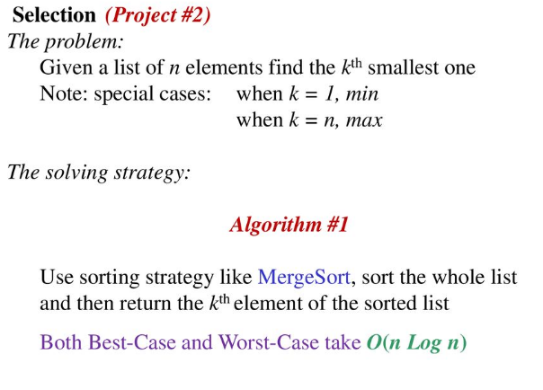
4. Selection Problem(Quick-Select)
Yogi Reddy M, Asst. Prof

Slide 100
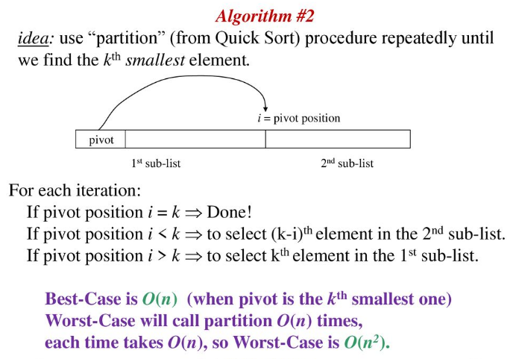
Which is similar to quick sort
Yogi Reddy M, Asst. Prof

Slide 101
Quick-Select
This approach is similar to the quick sort algorithm where we use the partition on the input array recursively. But unlike quicksort, which processes both sides of the array recursively, this algorithm works on only one side of the partition.
So we recur for either the left or right side according to the position of pivot.
Yogi Reddy M, Asst. Prof

Slide 102
Algorithm
Partition the array A[left .. right] into two subarrays A[left .. pos] and A[pos + 1 .. right] such that each element of A[left .. pos] is less than each element of A[pos + 1 .. right].
Computes the number of elements in the subarray A[left .. pos] i.e. count = pos - left + 1
if (count == K), then A[pos] is the Kth smallest element.
Otherwise determines in which of the two subarrays A[left .. pos-1] and A[pos + 1 .. right] the Kth smallest element lies.
  If (count > K) then the desired element lies on the left side of the partition
  If (count < K), then the desired element lies on the right side of the partition. Since we already know i values that are smaller than the kth smallest element of A[left .. right], the desired element is the (K - count)th smallest element of A[pos + 1 .. right].
  Base case is the scenario of single element array i.e left ==right. return A[left] or A[right].
Yogi Reddy M, Asst. Prof

Slide 103
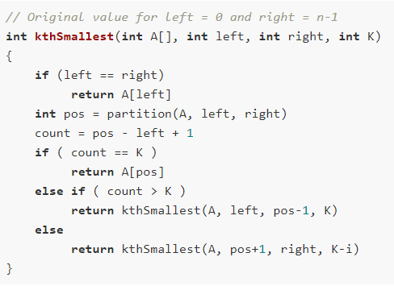
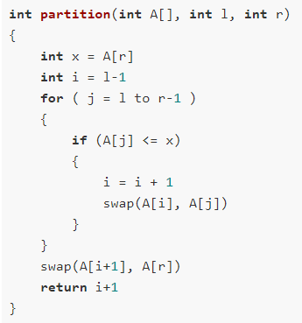
Pseudo code
Yogi Reddy M, Asst. Prof

Slide 104
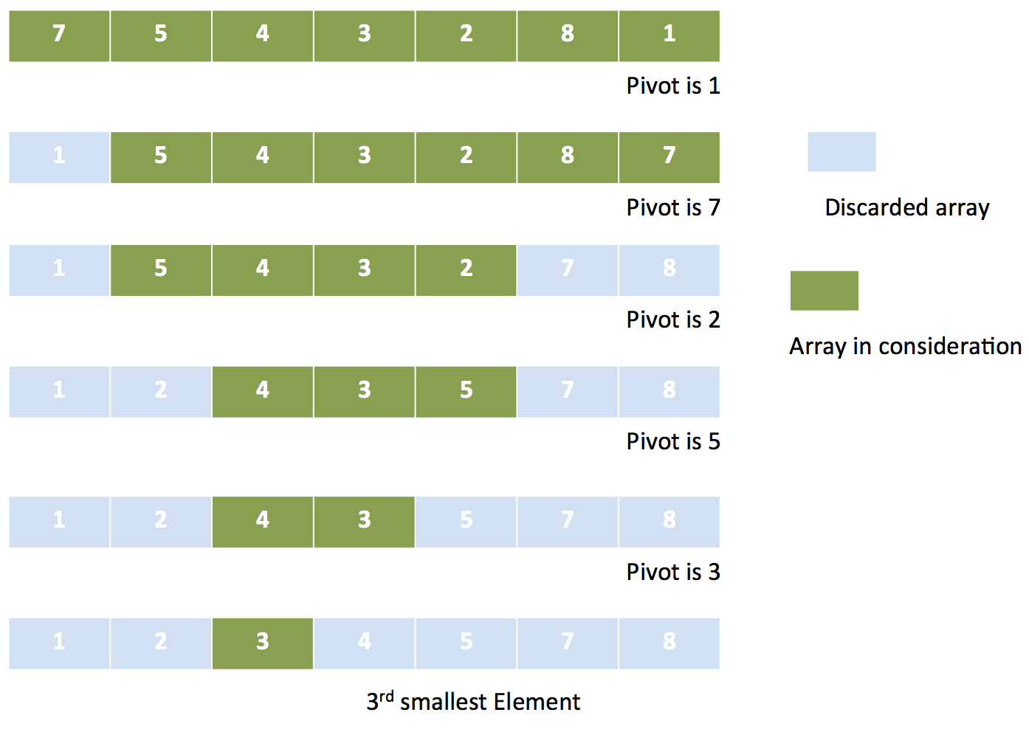
Yogi Reddy M, Asst. Prof

Slide 105
5.Strassen’s Matrix Multiplication
Yogi Reddy M, Asst. Prof

Slide 106
Basic Matrix Multiplication
Let A an B two n×n matrices. The product C=AB is also an n×n matrix.
void matrix_mult (){
for (i = 1; i <= N; i++) {
for (j = 1; j <= N; j++) {
for(k=1; k<=N; k++){
C[i,j]=C[i,j]+A[i,k] * B[k,j]; }
}}
Time complexity of above algorithm is
T(n)=O(n3)
Yogi Reddy M, Asst. Prof

Slide 107

Divide and Conquer technique
We want to compute the product C=AB, where each of A,B, and C are n×n matrices.
Assume n is a power of 2.
If n is not a power of 2, add enough rows and columns of zeros.
We divide each of A,B, and C into four n/2×n/2 matrices, rewriting the equation C=AB as follows:
Yogi Reddy M, Asst. Prof

Slide 108
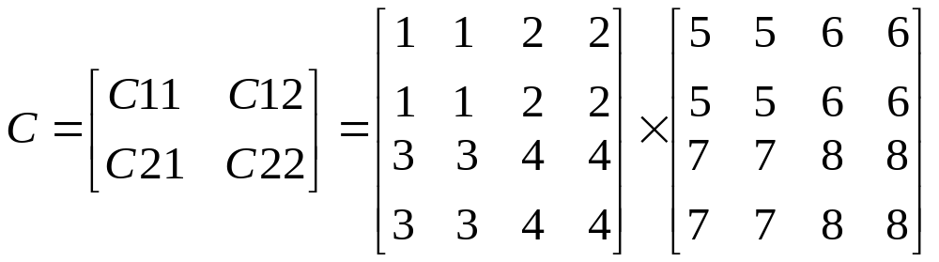
Then,
C₁₁=A₁₁B₁₁+A₁₂B₂₁
C₁₂=A₁₁B₁₂+A₁₂B₂₂
C₂₁=A₂₁B₁₁+A₂₂B₂₁
C₂₂=A₂₁B₁₂+A₂₂B₂₂
Each of these four equations specifies two multiplications of n/2×n/2 matrices and the addition of their n/2×n/2 products.
We can derive the following recurrence relation for the time T(n) to multiply two n×n matrices:
T(n)= c₁ if n<=2
8T(n/2)+ c₂n² if n>2
A₁₁
A₁₂
B₁₁
B₁₂
c₁₁
c₁₂
c₂₁
c₂₂
A₂₁
A₂₂
B₂₁
B₂₂
T(n) = O(n3)
This method is no faster than the ordinary method.
Yogi Reddy M, Asst. Prof

Slide 109
T(n)= 8T(n/2)+ c₂n²
=8 8T(n/4)+ c₂(n/2)² ⁺ c₂n²
= 8² T(n/4)+ c₂2n² ⁺ c₂n²
=8² 8T(n/8)+ c₂(n/4)² + c₂2n² + c₂n²
=8³ T(n/8)+ c₂4n² + c₂2n² + c₂n²
:
=8^{k}T(1)+ ………………+ c₂4n² + c₂2n² + c₂n²
⁼ 8^{log}₂^{n} c₁ + c n²
=n^{log}2 c₁ + c n² = n³ c₁+ cn² ⁼ O(n³ )
.
8
Yogi Reddy M, Asst. Prof

Slide 110
Strassen’s method
Matrix multiplications are more expensive than matrix additions or subtractions( O(n³) versus O(n²)).
Strassen has discovered a way to compute the multiplication using only 7 multiplications and 18 additions or subtractions.
His method involves computing 7 n×n matrices M₁,M₂,M₃,M₄,M₅,M₆, and M_{7,} then cij’^{s} are calculated using these matrices.
Yogi Reddy M, Asst. Prof

Slide 111
Formulas for Strassen’s Algorithm
M₁ = (A₁₁ + A₂₂) ∗ (B₁₁ + B₂₂)
M₂ = (A₂₁ + A₂₂) ∗ B₁₁
M₃ = A₁₁ ∗ (B₁₂ – B₂₂)
M₄ = A₂₂ ∗ (B₂₁ – B₁₁)
M₅ = (A₁₁ + A₁₂) ∗ B₂₂
M₆ = (A₂₁ – A₁₁) ∗ (B₁₁ + B₁₂)
M₇ = (A₁₂ – A₂₂) ∗ (B₂₁ + B₂₂)
C₁₁=M1 + M4 - M₅ + M₇
C₁₂= M₃ + M₅
C₂₁= M₂ + M₄
C₂₂=M₁ + M₃ - M₂ + M₆
Yogi Reddy M, Asst. Prof

Slide 112
    C₁₁ C₁₂ A₁₁ A₁₂ B₁₁ B₁₂
    = *
    C₂₁ C₂₂ A₂₁ A₂₂ B₂₁ B₂₂
    M₁ + M₄ - M₅ + M₇ M₃ + M₅
    =
    M₂ + M₄ M₁ + M₃ - M₂ + M₆
The resulting recurrence relation for T(n) is
T(n)= c₁ n<=2
7T(n/2) +c₂n² n>2
Yogi Reddy M, Asst. Prof

Slide 113
T(n)= 7T(n/2)+ c₂n²
=7 7T(n/4)+ c₂(n/2)² ⁺ c₂n²
= 7² T(n/4)+ 7/4c₂n² ⁺ c₂n²
=7² 7T(n/8)+ c₂(n/4)² + c₂2n² + c₂n²
=7³ T(n/8)+ (7/4)²c₂n² + 7/4c₂n² + c₂n²
:
=7^{k}T(1) + c₂n² 1+ 7/4 + (7/4)² + (7/4) ³+……………..+ (7/4)^{k-1}
= 7^{log}₂^{n} c₁ +c₂ n² (7/4)^{log}₂^{n}
= c₁ n^{log}₂⁷ + c₂ n² (7/4)^{log}₂^{n}
=c₁ n^{log}₂⁷ = O(n^{log}₂⁷) ~ O( n^{2.81})
Yogi Reddy M, Asst. Prof

Slide 114

T(n)= 7^{k}T(1) + c₂n² 1+ 7/4 + (7/4)² + (7/4) ³+……………..+ (7/4)^{k-1}
⁼ 7^{log}₂^{n} c₁ +c₂ n² (7/4)^{log}₂^{n}
⁼ c₁ n^{log}₂⁷ + c₂ n² (7/4)^{log}₂^{n}
=c₁ n^{log}₂⁷ = O(n^{log}₂⁷) ~ O( n^{2.81})
. .
.
Yogi Reddy M, Asst. Prof

Slide 115
6. Finding maximum and minimum
Divide and conquer approach for Max. & Min problem works in three stages.
  Stage1: If a₁ is the only element in the array, a₁ is the maximum and minimum.
  Satge2: If the array contains only two elements a₁ and a₂, then the single comparison between two elements can decide the minimum and maximum of them.
  Stage3: If there are more than two elements, the algorithm divides the array from the middle and creates two sub-problems. Both sub-problems are treated as an independent problem and the same recursive process is applied to them. This division continues until sub-problem size becomes one or two.
Yogi Reddy M, Asst. Prof

Slide 116
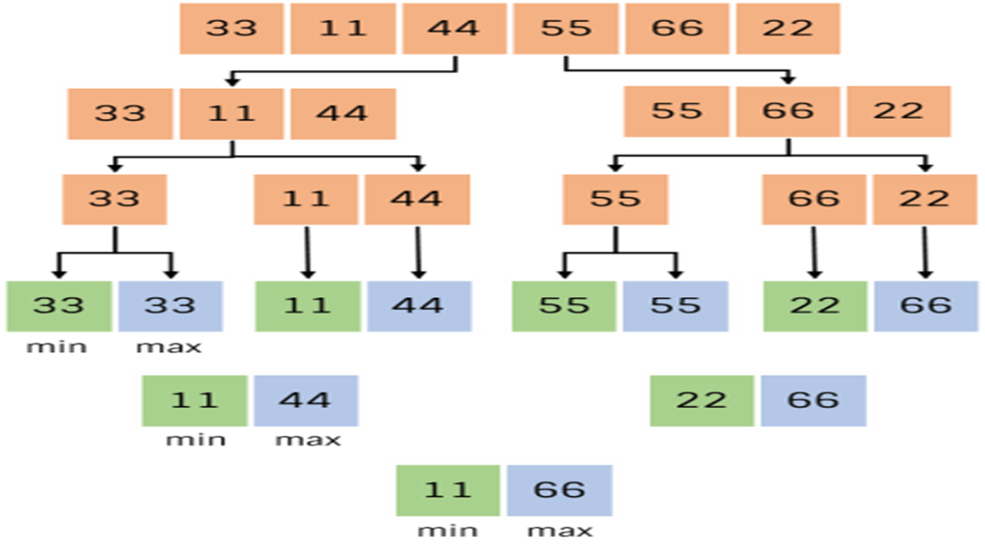
For example, find max and min from the sequence <33, 11, 44, 55, 66, 22> using divide and conquer approach
Yogi Reddy M, Asst. Prof

Slide 117
Algorithm DC_MAXMIN (A, low, high)
{ // Description : Find minimum and maximum element from array using divide and conquer approach
// Input : Array A of length n, and indices low = 0 and high = n - 1
// Output : (min, max) variables holding minimum and maximum element of array
if n == 1 then
return (A[1], A[1])
else if n == 2 then
if A[1] < A[2] then
return (A[1], A[2])
else
return (A[2], A[1])
else
mid ← (low + high) / 2
[LMin, LMax] = DC_MAXMIN (A, low, mid)
[RMin, RMax] = DC_MAXMIN (A, mid + 1, high)
if LMax > RMax then // Combine solution
max ← LMax
else
max ← RMax
if LMin < RMin then // Combine solution
min ← LMin
else
min ← RMin
return (min, max)
Yogi Reddy M, Asst. Prof

Slide 118
Time Complexity
DC_MAXMIN does two comparisons to determine the minimum and maximum element and creates two problems of size n/2, so the recurrence can be formulated as
0 if n = 1
1 if n = 2
T(n) =
2T(n/2) + 2 if n > 2
Let us solve this equation using interactive approach.
T(n) = 2T(n/2) + 2 … (1)
By substituting n by (n / 2) in Equation (1)
T(n/2) = 2T(n/4) + 2
⇒ T(n) = 2(2T(n/4) + 2) + 2
= 4T(n/4) + 4 + 2 … (2)
Yogi Reddy M, Asst. Prof

Slide 119
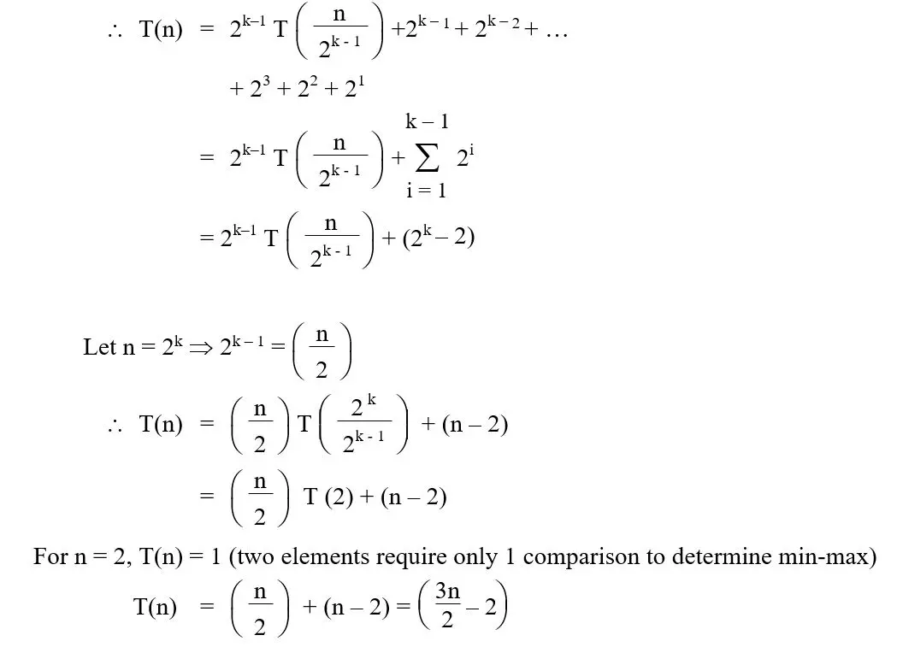
By substituting n by n/4 in Equation (1),
T(n/4) = 2T(n/8) + 2
Substitute it in Equation (1),
T(n) = 4[2T(n/8) + 2] + 4 + 2
= 8T(n/8) + 8 + 4 + 2
= 2³ T(n/2³) + 2³ + 2² + 2¹
After k – 1 iterations
O(n)
Yogi Reddy M, Asst. Prof

Slide 120


PAGE <number>
Yogi Reddy M, Asst. Prof

